Slide 1

Heart Health Analysis
By: Alex R., Emma K., Judy S., Nick N., & Summer B.

Slide 2

Overview
Using Machine Learning, our group set out to create two calculators, one for a clinical MD, and another for the leymen patient. The calculator is designed to give a prediction of an individual's life longevity based on their input. Our hopes are to indicate to patients and doctors identifiable steps one can take to maximize longevity.
Notes:
Emma

Slide 3
Problems to solve
1
Create a patient friendly calculator to determine the risk of heart disease related mortality based on common health parameters.
Build a simple machine learning model that will provide the risk percentage upon a patient inputting their basic health information.
Create a more complex calculator for health professionals to make more precise predictions on risk of heart disease related mortality based on more complex health parameters.
Build a complex machine learning model that will provide a more accurate assessment of the mortality risk a health provider’s patient faces upon inputting in depth patient health information.
2
Notes:
Summer

Slide 4
Simple Logistic Regression Model
Complex Logistic Regression Model
Explanatory:
Age
Anemia
Diabetes
High Blood Pressure
Sex
Smoking
Response:
Death Event
Explanatory:
Age
Anemia
Creatine Phosphokinase
Diabetes
Ejection Fraction
High Blood Pressure
Platelets
Serum Creatinine
Serum Sodium
Sex
Smoking
Time
Response:
Death Event
Notes:
Emma and Summer

Slide 5
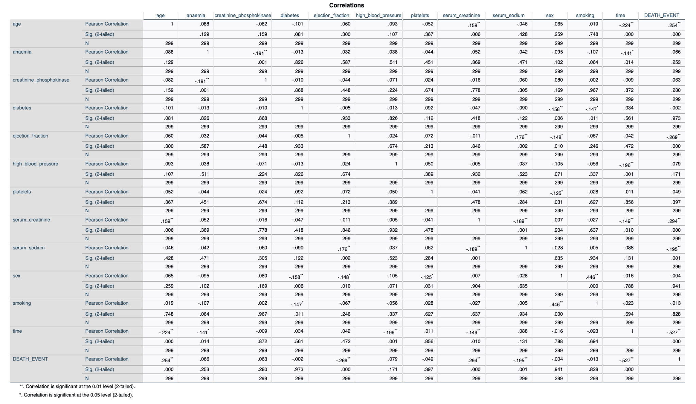
Notes:
Emma

Slide 6
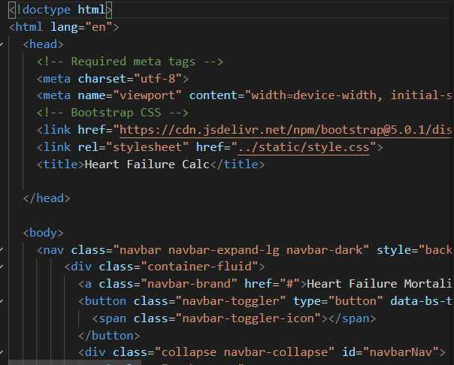
Overall Website Design
HTML/CSS/FLASK:
Using Bootstrap and HTML, we formatted the page to display tabs labeled Patient Calculator, Clinical Calculator, and Resources. Flask was used to deploy the website and work with the machine learning.
Notes:
Alex

Slide 7
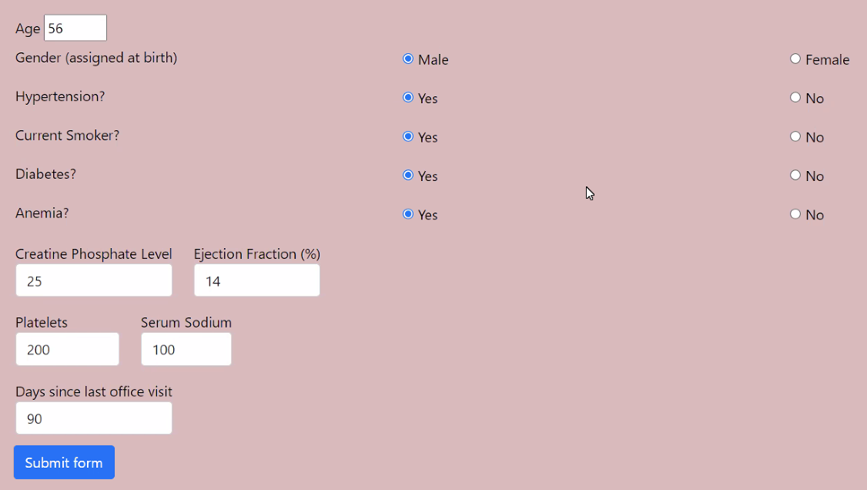
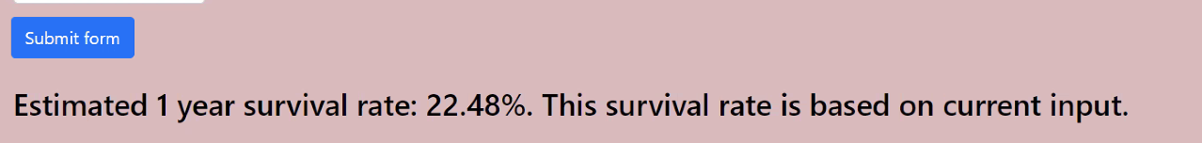
Patient and Clinical Calculator HTML/CSS
Created the radio buttons
Added code to make the radio buttons required fields
If not filled out would make an error message to fill out he field
The input buttons were a range and if outside range created error message
The prediction calculation display on the screen is coordinated with the submit button
Notes:
Judy and Nick

Slide 8

Data
Validation
Controlled inputs with HTML5 elements & attributes
Set attributes with min & max values for input boxes
Set “Type” attribute to “Number” to stop string data from being submitted
Used Jinja code to repopulate form after submission
Grabbed values in Flask and redisplayed them after form was submitted with Jinja code
Prior to adding this code the form would reset to blank and display a result
Jinja helped to hide result text until the form was submitted for the first time and a result was received from Flask app
Result % updates with new submissions
Notes:
Nick

Slide 9
Future Directions:
Lessons Learned:
Developing a coronary artery predictor
Demographic information added to the model
More patient resources
More data
Merging multiple moving parts -need to be very careful
Learned the fundamental mechanisms that allow us to maximize our predictive efforts for data analysis
Enhanced html/css skills
Jinja
Notes:
Alex

Slide 10

Thank you!

